Slide 1
Designing Your VMware Virtual Infrastructure for Optimal Performance, Resilience and Availability –
Straight from the Source
Deji Akomolafe – VMware
David Klee – Heraflux Technologies
Cody Chapman – Heraflux Technologies

Slide 2




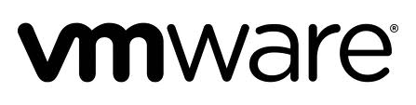
Dèjì Akọ́mọláfẹ́
@dejify
  Staff Solutions Architect, VMware Global Technical and Professional Services
  Microsoft Applications Virtualization Lead
  Member of VMware CTO Ambassador Program
  20+ years IT experience, specializing in Microsoft technologies
  Former Microsoft MVP in multiple designations
    Exchange Server
    Directory Services
    Windows Security
  Speaker at:
    VMworld | EMCworld | VMUG | SQL Saturday
  https://blogs.vmware.com/apps
  http://www.dejify.com
  http://bit.ly/2h3Rf53

Slide 3




About David Klee
@kleegeek
davidklee.net
heraflux.com
linkedin.com/in/davidaklee
Specialties / Focus Areas / Passions:
Performance Tuning & Troubleshooting
Virtualization
Cloud Enablement
Infrastructure Architecture
Health & Efficiency
Capacity Management
Founder & Chief Architect

Slide 4

About Cody Chapman
@codyrchapman
heraflux.com
linkedin.com/in/codyrchapman
Specialties / Focus Areas / Passions:
Performance Tuning & Troubleshooting
Virtualization
Infrastructure Architecture
Scripting and Automation
Health & Efficiency
Solutions Architect

Slide 5
Things we can all agree on
Virtualization is mainstream
You want to virtualize your applications
You care about the outcome
Your applications are Important
That is WHY we are here

Slide 6
Is the Application “Critical”?
Business Applications Stack
+
Normal Business Processes =
Operations / Profitability
Do business processes depend on it?
Is the outage impactful?
Outage NOT easily survivable?
Outage NOT easily recoverable?
Will it/you be missed?

Slide 7
Business Critical Applications Characteristics
Performance
  Timely process completion is critical
  Must avoid bottleneck
Availability
  Must be highly available
  Must be resilient and redundant
  MTBF must be very high
Recoverability
  RPO, RTO, MTD, WRT must all be very low
  Recovery plans must be verifiable and repeatable
Scale
  Should be adaptive and grow with little reconfiguration effort

Slide 8
Why Virtualize Critical Applications
Resource Maximization
Server resources increase too much for one application instance
Enhanced Availability
Native application HA features incomplete for most critical applications
Dev Testing
Virtualization improves adaptivity and elasticity
Rapid Provisioning And Scaling
All the known and latent benefits of virtualization
Job Security
It’s 2016, and all the cool kids have done it
vSphere HA features complement native App HA features
Result is improved availability
Virtualization improves resource utilization
Reduces wastage
You can’t get to the “Cloud” without virtualizing
Lifecycle management easier in virtual (provisioning/de-provisioning)
Lower TCO
Significant savings in power, cooling, and datacenter space, and administration
Project lifecycle considerably reduced

Slide 9
Common Objections
To Virtualizing Critical Applications

Slide 10

Common Objections to Virtualizing BCA
Performance
Platform Security
Knowledge / Education
Virtualization is “disruptive”
Workload Availability
Cost
Vendor Support
Acquisition
Deployment
Maintenance

Slide 11

Common Objections to Virtualization - Vendor Support
Vendor | Reference
Everything Business Critical Applications on VMware vSphere http://www.vmware.com/business-critical-apps/ | http://vmw.re/15MO7oL
Microsoft Supports Virtualization of ALL its Critical Applications | http://bit.ly/1uvVRkk
Exchange Server | http://bit.ly/1H1xYfu
SQL Server | http://bit.ly/15MrBMy
Oracle mySupport (Note 249212.1) | http://bit.ly/15DrLW3
SAP General Support Statement for Virtual Environments (Note 1492000) | http://bit.ly/1Ctkd4T
SAP on VMware | http://bit.ly/15NEiH4
SAP Notes Related to VMware | http://bit.ly/1wyohKe
For when you are in a jam
http://www.tsanet.org

Slide 12
Common Objections to Virtualization - Security
Yes, we did, too, and we quashed it – http://vmw.re/1x95NBV
I heard about a TPS Security Bug
I have a Regulatory Compliance Requirement for “Hard” Separation
Multi-tenancy and “fencing” allowed
Multi-tenancy is NOT a requirement
vCenter privileges do NOT elevate guest operating system or application privileges
Privilege Escalation
Deviates from our build standards
Virtualization improves standardization
Use templates for optimization
How about the “stolen server”?
Or “stolen/copied backup tape”?
We have a solution in just a few slides…
The fear of the “stolen vmdk”
The fear of the “stolen vmdk”

Slide 13

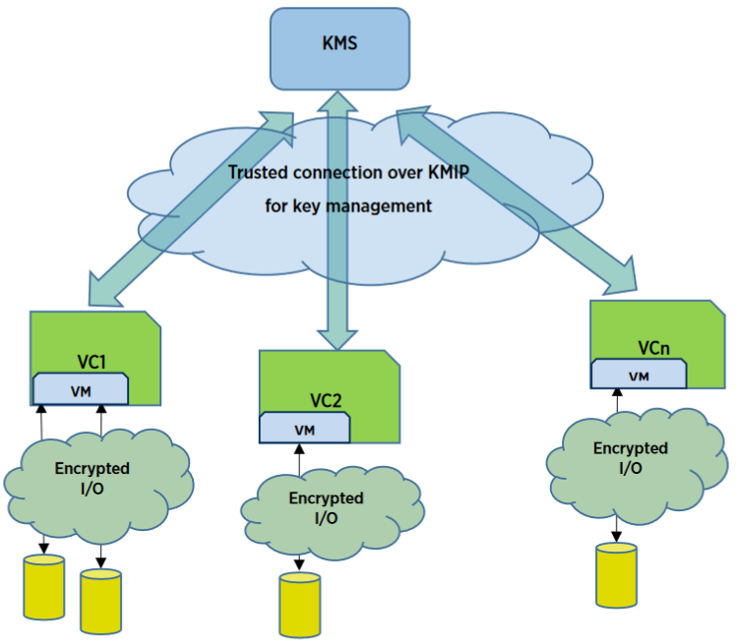
Stolen VMDK? Meet VM Encryption
The “Dye Pack” of Enterprise Virtualization
Introduced in vSphere 6.5
Secures Data in a VM’s VMDK
Uses vSphere APIs for I/O filtering (VAIO)
VM Possesses Decryption Key
vCenter Serves as Broker/Facilitator Only
Data Meaningless to Unauthorized Entities
No SPECIAL Hardware Required *
* AES-NI Capable Server Hardware Improves Performance

Slide 14
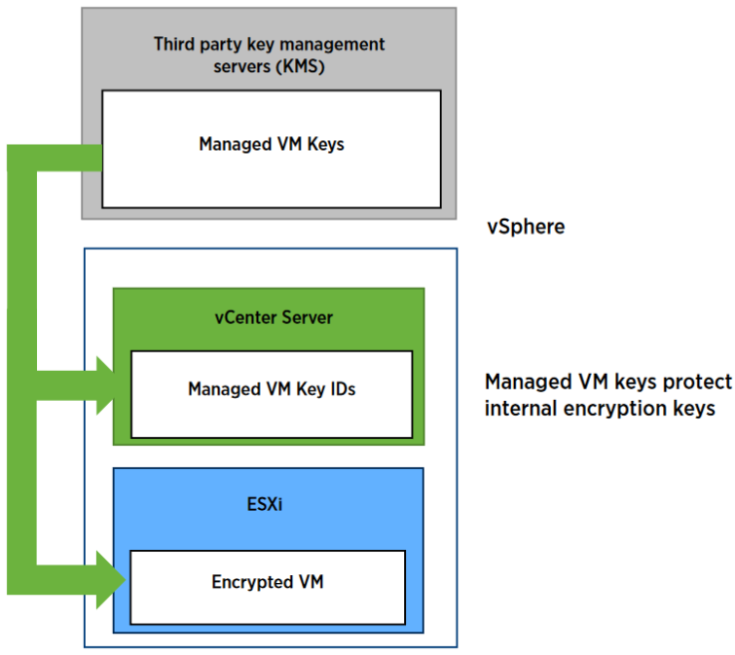
VM Encryption – How it Works
Customer-Supplied Key Management Server (KMS)
  Customer-owned and Operated
Centralized Repository for Crypto Keys
  No Special Requirement – KMIP 1.1-compliant
KMS Clusters can be created
  For Redundancy and Availability
vCenter is Manually Enrolled in KMS
  Establishing Trust
vCenter Obtains Crypto KEKs from KMS
  Distributes KEKs to ESXi
ESXi Uses KEK to Generate DEK
  Used for Encrypting/Decrypting VM Files
  Encrypted DEKs Stored in VM Config Files
  KEK for VMs Resides in ESXi’s Memory
IF ESXi Powered-Cycled (or Otherwise Unavailable), vCenter Must Request New KEK for Host
If Encrypted VM Unregistered, vCenter Must Request KEK During Re-Registration
VM Unable to Power-On if Request Fails

Slide 15
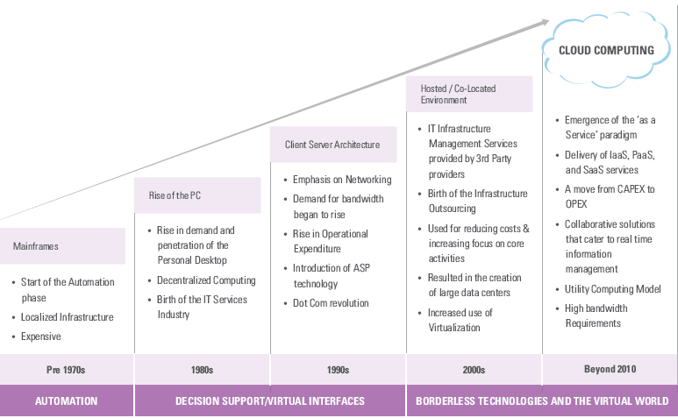
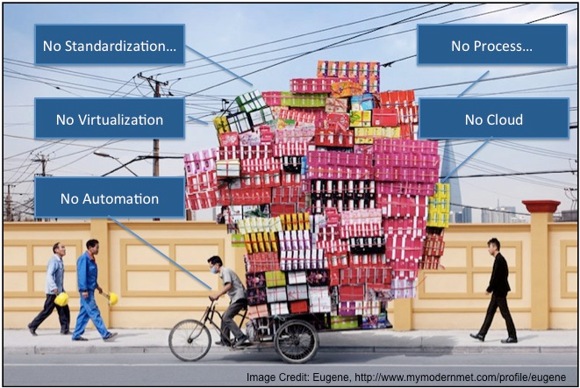
Common Objections to Virtualization - Knowledge / Education
The Fear of Change…. Leads to inertia

Slide 16
Virtualizing Applications for Performance and Scale

Slide 17
Can vSphere handle the load?
Configuration Item | ESXi 6.0 | ESXi 6.5
Virtual CPUs per virtual machine (Virtual SMP) | 128 | 128
RAM per virtual machine | 4TB | 6TB
Virtual machine swapfile size | 4TB | 6TB
Logical CPUs per host | 480 | 576
Virtual CPUs per host | 4096 | 4096
Virtual machines per host | 1024 | 1024
Virtual CPUs per core | 32 | 32
Virtual CPUs per FT virtual machine | 4 | 4
FT Virtual machines per host | 4 | 4
RAM per host | 4TB | 6TB
Hosts per cluster | 64 | 64
Virtual Machines per cluster | 8000 | 8000
LUNs per cluster/host | 254 | 512
Paths per cluster/host | 1024 | 2048
LUN / VMDK Size | 62 TB | 62 TB
Virtual NICs per virtual machine | 10 | 10

Slide 18
Ensuring Application Performance on vSphere
Physical Hardware
VMware HCL
BIOS / Firmware
Hyper-threading
Power / C-States
ESXi Host
Power
Virtual Switches/Portgroups
Virtual Machine
Resource Allocation
Storage
Memory
CPU / vNUMA
Networking
vSCSI Controller
Guest Operating System
CPU
Power
Networking
Storage IO
vMotion Portgroups
NUMA

Slide 19

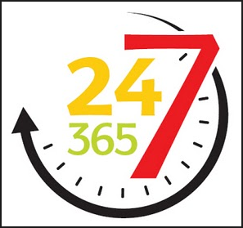
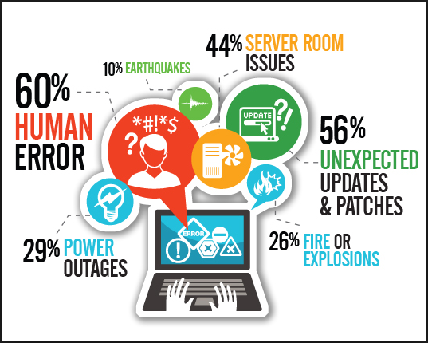
Designing to Requirements – Know the Constraints
Performance and Scale
Availability and Reliability
Recoverability
Design Constraints
Budget
Personnel
Compliance
Storage
Networking
Server Hardware
vSphere
Windows
Application

Slide 20
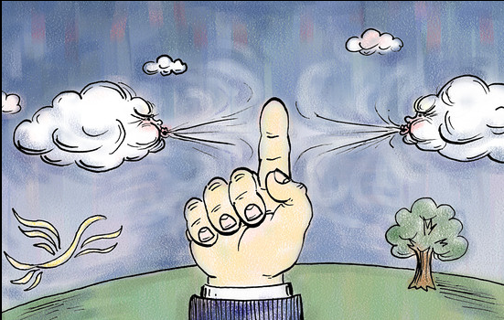
Performance-based Designing Tenets
Understand your Needs
Conduct Baseline Testing of Desired Sizes
Review Workload Profiles and Characteristics
We
Have a Design
Establish Desired Workload Sizing
Review Current State Utilization
Factor in HA/FT/BCDR
Requirements
Add Future Growth Projection

Slide 21
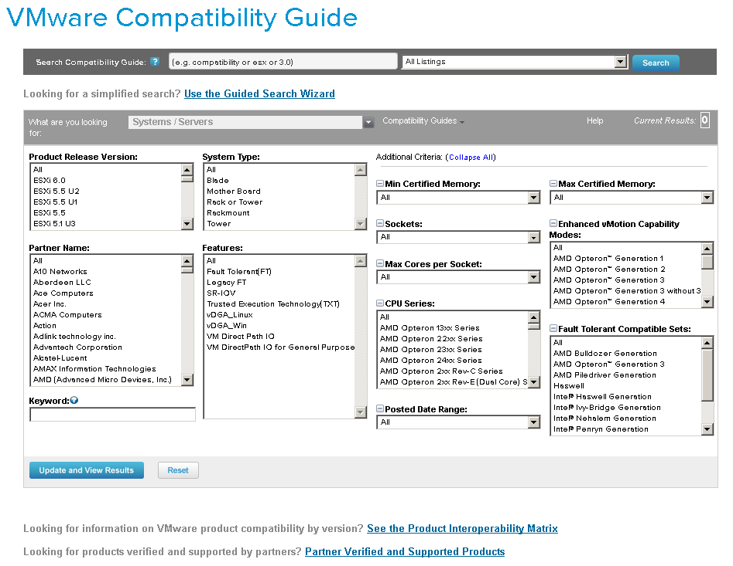
Everything rides on the physical hardware – E.V.E.R.Y.T.H.I.N.G
Physical Hardware
  Hardware MUST Be On VMware’s HCL
    Outdated drivers, firmware and BIOS Revs adversely impact virtualization
  Always Disable unused physical hardware devices
  Leave memory scrubbing rate in BIOS at default
    Incorrect firmware, BIOS and Drivers Revs adversely impact virtualization
  Default hardware Power Scheme unsuitable for virtualization
    Change Power setting to “OS controlled”
    Set ESXi Power Management Policy to “High Performance”
    Enable Turbo Boost (or Equivalent)
    Disable Processor C-states / C1E halt State
  Enable All Cores – Don’t let hardware turn off cores dynamically
    Wrong BIOS, Firmware, and Drivers Revs Adversely Impact Virtualization

Slide 22
Time-Keeping in your vSphere Infrastructure

Slide 23
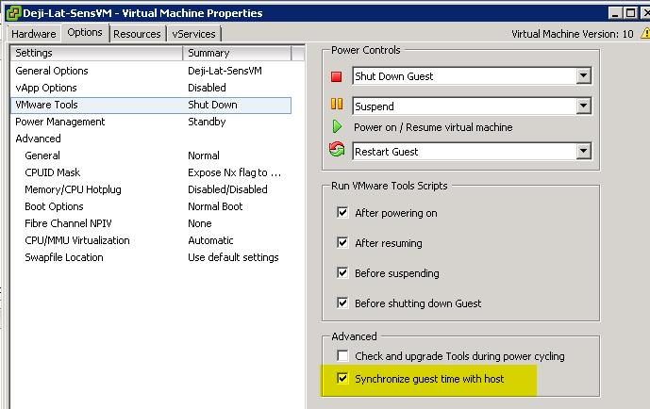
Back in the Days…..

Slide 24
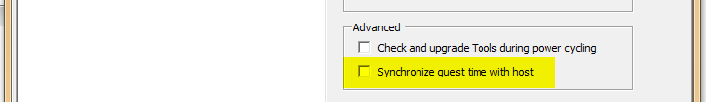
That was Problematic …..

Slide 25
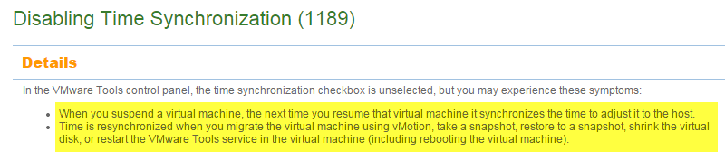
But, That, Too, Is Insufficient
Because Even When You Do THAT, We Still Do THIS
Reference: http://kb.vmware.com/kb/1189

Slide 26
Preventing Bad Time Sync
Ensure Hardware Clock on ESXi Hosts is CORRECT
Configure Reliable NTP on ALL ESXi Hosts
Configure in-Guest NTP Source
IF Internal Authoritative Time Source Virtualized
    (e.g.) Windows Active Directory PDC
  Disable DRS for the VM
  Use Host-Guest Affinity Rule for the VM
    Helps you find it in Emergency

Slide 27
Completely Disabling Time Sync
Add the Following VM’s Advanced Configuration Options to your VMs/Templates
tools.syncTime = “0”
time.synchronize.continue = “0”
time.synchronize.restore = “0”
time.synchronize.resume.disk = “0”
time.synchronize.shrink = “0”
time.synchronize.tools.startup = “0”
time.synchronize.tools.enable = “0”
time.synchronize.resume.host = “0”
To add these settings across multiple VMs at once, use VMware vRealize Orchestrator:
http://blogs.vmware.com/apps/2016/01/completely-disable-time-synchronization-for-your-vm.html

Slide 28

Designing for Performance
NUMA
    To enable or to not enable? Depends on the Workloads
    More on NUMA later
Sockets, Cores and Threads
    Enable Hyper-threading
    Size to physical cores, not logical hyper-threaded cores.
Reservation, Limits, Shares and Resource Pools
    Use reservation to guarantee resources – IF mixing workloads in clusters
    Use limits CAREFULLY for non-critical workloads
      Limits must never be less than Allocated Values *
    Use Shares on Resource Pools
      Only to contain non-critical Workload’s consumption rate
      Resource Pools must be continuously managed and reviewed
      Avoid nesting Resource Pools – complicates capacity planning
*Only possible with scripted deployment

Slide 29

Designing for Performance
Network
  Use VMXNET3 Drivers
    VMXNET3 Template Issues in Windows 2008 R2 - kb.vmware.com\kb\1020078
    Hotfix for Windows 2008 R2 VMs - http://support.microsoft.com/kb/2344941
    Hotfix for Windows 2008 R2 SP1 VMs - http://support.microsoft.com/kb/2550978
    Remember Microsoft’s “Convenience Update”? https://support.microsoft.com/en-us/kb/3125574
  Disable interrupt coalescing – at vNIC level
  On 1GB network, use dedicated physical NIC for different traffic type
Storage
  Latency is king - Queue Depths exist at multiple paths (Datastore, vSCSI, HBA, Array)
  Adhere to storage vendor’s recommended multi-pathing policy
  Use multiple vSCSI controllers, distribute VMDKS evenly
  Disk format and snapshot
  Smaller or larger datastores?
    Determined by storage platform and workload characteristics (VVOL is the future)
  IP Storage? - Jumbo Frames, if supported by physical network devices

Slide 30
The more you know…
It’s the Storage, Stupid
There is ALWAYS a Queue
More is NOT Better
Know your hardware NUMA boundary. Use it to guide your sizing
Use Your Tools
Don’t Blame the vNIC
VMXNET3 is NOT the problem
Consider Disabling Interrupt Coalescing
Check in-guest network tuning options – e.g. RSS
Beware of CPU fairness
There is no place like 127.0.0.1 (VM’s Home Node)
Beware of the memory tax
One-lane highway vs 4-Lane highway. More is better
PVSCSI for all data ask volumes
Ask Your Storage Vendor about multi-pathing policy
Virtualizing does NOT change OS/App administrative tasks
ESXTop – Native to ESXi
Visualesxtop - https://labs.vmware.com/flings/visualesxtop
Esxplot - https://labs.vmware.com/flings/esxplot
Outdated VMware Tools MAY be the problem

Slide 31
Storage Optimization

Slide 32

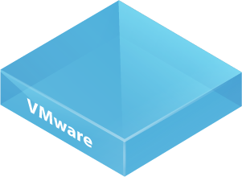





Factors affecting storage performance
Application
Adapter type
vSCSI adapter
Number of virtual disks
Virtual adapter queue depth
VMKernel
VMKernel admittance ( Disk.SchedNumReqOutstanding)
Per path queue depth
Adapter queue depth
Storage network (link speed, zoning, subnetting)
FC/iSCSI/NAS
LUN queue depth
Array SPs
HBA target queues
Number of disks (spindles)

Slide 33


Nobody Likes Long Queues
Arriving Customers
Queue
Checkout
input
output
server
queue time
service time
Utilization = busy-time at server / time elapsed
response time

Slide 34

Additional vSCSI controllers improves concurrency
Guest Device
vSCSI Device
Storage Subsystem

Slide 35
Optimize for Performance – Queue Depth
vSCSI Adapter
  Be aware of per device/adapter queue depth maximums (KB 1267)
  Use multiple PVSCSI adapters
VMKernel Admittance
  VMKernel admittance policy affecting shared datastore (KB 1268), use dedicated datastores for DB and Log Volumes
  VMKernel admittance changes dynamically when SIOC is enabled (may be used to control IOs for lower-tiered VMs)
Physical HBAs
  Follow vendor recommendation on max queue depth per LUN (http://kb.vmware.com/kb/1267)
  Follow vendor recommendation on HBA execution throttle
  Be aware settings are global if host is connected to multiple storage arrays
  Ensure cards are installed in slots with enough bandwidth to support their expected throughput
  Pick the right multi-pathing policy based on vendor storage array design (ask your storage vendor)

Slide 36
Increase PVSCSI Queue Depth
Just increasing LUN, HBA queue depths is NOT ENOUGH
PVSCSI - http://KB.vmware.com/kb/2053145
Increase PVSCSI Default Queue Depth (after consultation with array vendor)
  Linux:
    Add following line to /etc/modprobe.d/ or /etc/modprobe.conf file:
    options vmw_pvscsi cmd_per_lun=254 ring_pages=32
  OR, append these to the appropriate kernel boot arguments (grub.conf or grub.cfg)
    vmw_pvscsi.cmd_per_lun=254
    vmw_pvscsi.ring_pages=32
  Windows:
    Key: HKLM\SYSTEM\CurrentControlSet\services\pvscsi\Parameters\Device
      Value: DriverParameter | Value Data: "RequestRingPages=32,MaxQueueDepth=254“

Slide 37
Optimize for Performance – Storage Network
Link Type/Speed
  FC vs. iSCSI vs. NAS
  Latency suffers when bandwidth is saturated
Zoning and Subnetting
  Place hosts and storage on the same switch, minimize Inter-Switch Links
  Use 1:1 initiator to target zoning or follow vendor recommendation
  Enable jumbo frame for IP based storage (MTU needs to be set on all connected physical and virtual devices)
  Make sure different iSCSI IP subnets cannot transmit traffic between them

Slide 38
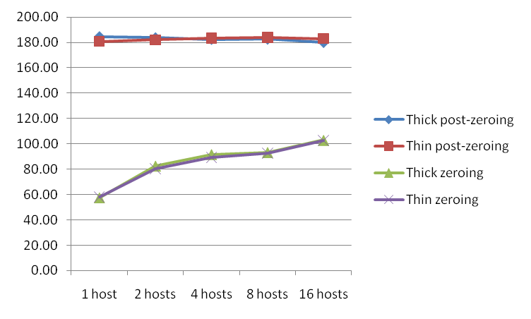
“Thick” vs “Thin”
MBs I/O Throughput
Thin (Fully Inflated and Zeroed) Disk Performance = Thick Eager Zero Disk
Performance impact due to zeroing, not result of allocation of new blocks
To get maximum performance from the start, must use Thick Eager Zero Disks (think Business Critical Apps)
Maximum Performance happens eventually, but when using lazy zeroing, zeroing needs to occur before you can get maximum performance
Choose Storage which supports VMware vStorage APIs for Array Integration (VAAI)
http://www.vmware.com/pdf/vsp_4_thinprov_perf.pdf

Slide 39
VMFS or RDM?
  Generally similar performance http://www.vmware.com/files/pdf/performance_char_vmfs_rdm.pdf
  vSphere 5.5 and later support up to 62TB VMDK files
  Disk size no longer a limitation of VMFS
VMFS | RDM
Better storage consolidation – multiple virtual disks/virtual machines per VMFS LUN. But still can assign one virtual machine per LUN | Enforces 1:1 mapping between virtual machine and LUN
Consolidating virtual machines in LUN – less likely to reach vSphere LUN Limit of 255 | More likely to hit vSphere LUN limit of 255
Manage performance – combined IOPS of all virtual machines in LUN < IOPS rating of LUN | Not impacted by IOPS of other virtual machines
  When to use raw device mapping (RDM)
  Required for shared-disk failover clustering
  Required by storage vendor for SAN management tools such as backup and snapshots
  Otherwise use VMFS

Slide 40
Example Best Practices for VM Disk Layout
(Microsoft SQL Server)
Characteristics:
OS on shared DataStore/LUN
1 database; 4 equally-sized data files across 4 LUNs
1 TempDB; 4 (1/vCPU) equally-sized tempdb files across 4 LUNs
Data, TempDB, and Log files spread across 3 PVSCSI adapters
  Data and TempDB files share PVSCSI adapters
Virtual Disks could be RDMs
Advantages:
Optimal performance; each Data, TempDB, and Log file has a dedicated VMDK/Data Store/LUN
I/O spread evenly across PVSCSI adapters
Log traffic does not contend with random Data/TempDB traffic
Disadvantages:
You can quickly run out of Windows driver letters!
More complicated storage management

Slide 41
Realistic VM Disk Layout (Microsoft SQL Server)
Characteristics:
OS on shared DataStore/LUN
1 database; 8 Equally-sized data files across 4 LUNs
1 TempDB; 4 files (1/vCPU) evenly distributed and mixed with data files to avoid “hot spots”
Data, TempDB, and Log files spread across 3 PVSCSI adapters
Virtual Disks could be RDMs
Advantages:
Fewer drive letters used
I/O spread evenly/TempDB hot spots avoided
Log traffic does not contend with random Data/TempDB traffic

Slide 42
Lets talk about CPU, vCPUs and other Things

Slide 43
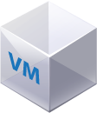


Optimizing Performance – Know Your NUMA
8 vCPU VMs
less than
45GB RAM
on each VM
ESX Scheduler
If VM is sized greater
than 45GB or 8 CPUs,
Then NUMA interleaving and
subsequent migration
occur and can cause
30% drop in memory
throughput performance
Memory
Memory
Memory
Memory
Proc 1
Memory
Memory
Proc 2
Memory
Each NUMA
Node has 94/2
45GB (less 4GB for
hypervisor overhead)
Memory
Memory
Memory
96 GB RAM
on Server
Memory
Memory

Slide 44
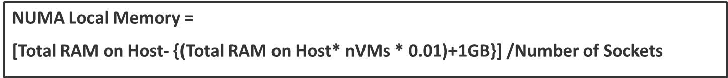
NUMA Local Memory with Overhead Adjustment
Number of Sockets
On vSphere host
vSphere Overhead
Number of VMs
On vSphere host
vSphere RAM
overhead
Physical RAM
On vSphere host
Physical RAM
On vSphere host
1% RAM
overhead

Slide 45
NUMA and vNUMA FAQ!
Shall we Define NUMA Again? Nah…..
Why VMware Recommends Enabling NUMA
  Modern Operating Systems are NUMA-aware
  Some applications are NUMA-aware (some are not)
  vSphere Benefits from NUMA
Use it, People
  Enable Host-Level NUMA
    Disable “Node Inter-leaving” in BIOS – on HP Systems
    Consult Hardware Vendor for SPECIFIC Configuration
Virtual NUMA
  Auto-enabled on vSphere for Any VM with 9 or more vCPUs
  Want to use it on Smaller VMs?
    Set “numa.vcpu.min” to # of vCPUs on the VM
CPU Hot-Plug DISABLES Virtual NUMA
vSphere 6.5 changes vNUMA config

Slide 46
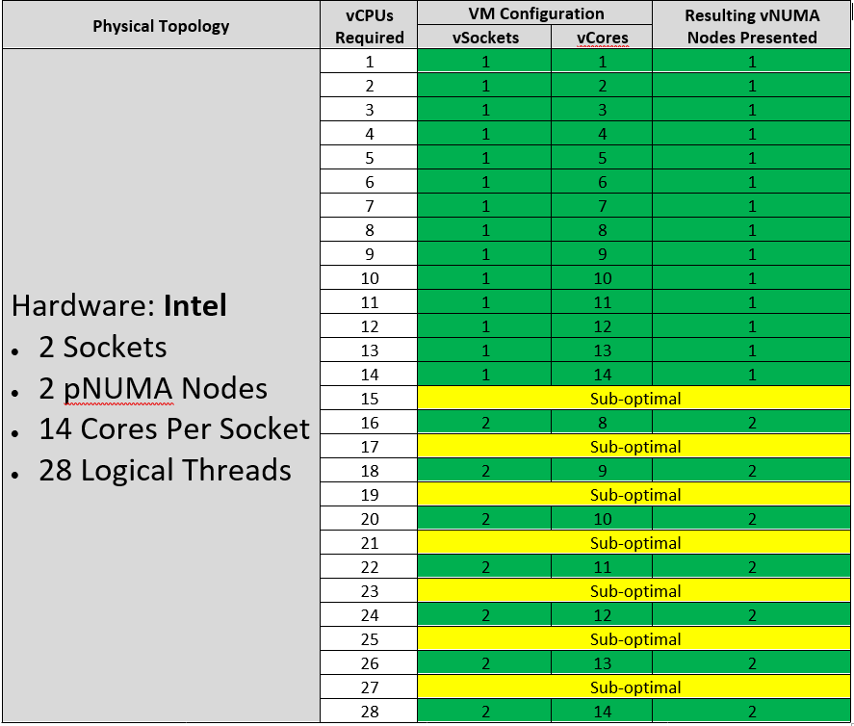
vSphere 6.5 vCPU Allocation Guidance

Slide 47
NUMA Best Practices
Avoid Remote NUMA access
  Size # of vCPUs to be <= the # of cores on a NUMA node (processor socket)
    Where possible, align VMs with physical NUMA boundaries
  For wide VMs, use a multiple or even divisor of NUMA boundaries
  http://www.vmware.com/files/pdf/techpaper/VMware-vSphere-CPU-Sched-Perf.pdf
Hyper-threading
  Initial conservative sizing: set vCPUs equal to # of physical cores
  HT benefit around 30-50%, < for CPU intensive batch jobs (based on OLTP workload tests)
Allocate vCPUs by socket count
  Default “Cores Per Socket” is set to “1”
  Applicable to vSphere versions prior to 6.5. Not as relevant in 6.5
ESXTOP to monitor NUMA performance in vSphere
  Coreinfo.exe to see NUMA topology in Windows Guest
vMotioning VMs between hosts with dissimilar NUMA topology leads to performance issues

Slide 48
Non-Wide VM Sizing Example (VM fits within NUMA Node)
1 vCPU per core with hyper-threading OFF
  Must license each core for SQL Server
1 vCPU per thread with hyper-threading ON
  10%-25% gain in processing power
  Same licensing consideration
  HT does not alter core-licensing requirements
“numa.vcpu.preferHT” to true to force 24-way VM to be scheduled within NUMA node

Slide 49
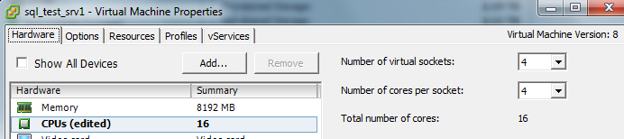
Wide VM Sizing Example (VM crosses NUMA Node)
Extends NUMA awareness to the guest OS
Enabled through multicore UI
  On by default for 9+ vCPU multicore VM
  Existing VMs are not affected through upgrade
  For smaller VMs, enable by setting numa.vcpu.min=4
Do NOT turn on CPU Hot-Add
For wide virtual machines, confirm feature is on for best performance

Slide 50
Designing for Performance
The VM itself matters – In-guest optimization
  Windows CPU Core Parking = BAD
    Set Power to “High Performance” to avoid core parking
    Relevant IF ESXi Host Power Setting NOT “High Performance”
  Windows Receive Side Scaling settings impact CPU utilization
    Must be enabled at NIC and Windows Kernel level
      Use “netsh int tcp show global” to verify
      More on this later
Application-level tuning
  Follow vendor’s recommendation
  Virtualization does not change the consideration

Slide 51
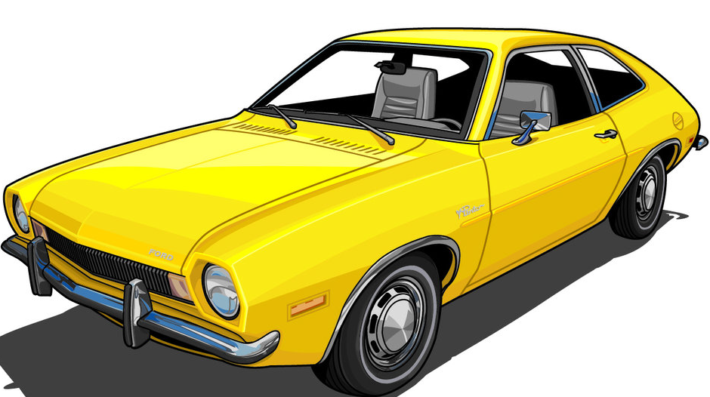
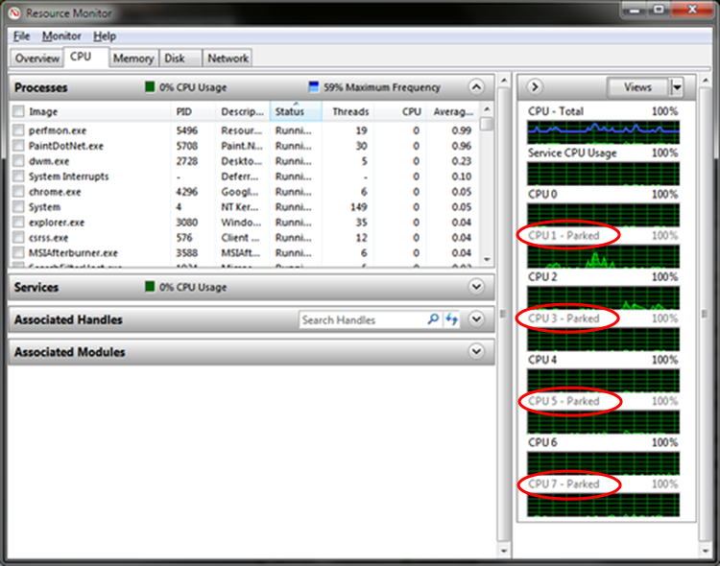
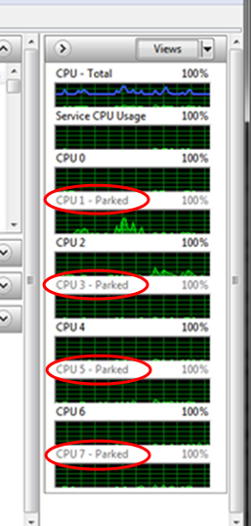
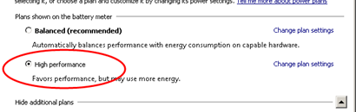
Why Your Windows App Server Lamborghini Runs Like a Pinto
Default “Balanced” Power Setting Results in Core Parking
  De-scheduling and Re-scheduling CPUs Introduces Performance Latency
  Doesn’t even save power - http://bit.ly/20DauDR
  Now (allegedly) changed in Windows Server 2012
How to Check:
    Perfmon:
      If "Processor Information(_Total)\% of Maximum Frequency“ < 100, “Core Parking” is going on
    Command Prompt:
      “Powerfcg –list” (Anything other than “High Performance”? You have “Core Parking”)
Solution
  Set Power Scheme to “High Performance”
  Do Some other “complex” Things - http://bit.ly/1HQsOxL

Slide 52
Memory Optimization

Slide 53
Memory Reservations
Guarantees allocated memory for a VM
The VM is only allowed to power on if the CPU and memory reservation is available (strict admission)
If Allocated RAM = Reserved RAM, you avoid swapping
Do NOT set memory limits for Mission-Critical VMs
  If using Resource Pools, Put Lower-tiered VMs in Resource Pools
Some Applications Don’t Support “Memory Hot-add”
  E.g. Microsoft Exchange Server CANNOT use Hot-added RAM
Don’t use it on ESXi versions lower than 6.0
Virtual:Physical memory allocation ratio should not exceed 2:1
Remember NUMA? It’s not just about CPU
  Fetching remote memory is VERY expensive
  Use “numa.vcpu.maxPerVirtualNode” to control memory locality
What about Dynamic Memory?
Not Supported by Most Microsoft’s Critical Applications
Not a feature of VMware vSphere

Slide 54
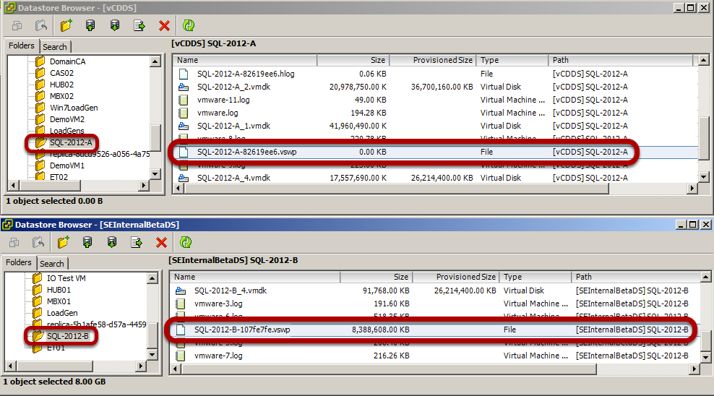
Memory Reservations and Swapping on vSphere
  Setting a reservation creates zero (or near-zero) swap file

Slide 55
Network Optimization

Slide 56





vSphere Distributed Switch (VDS) Overview
VMware vCenter Server
Unified network virtualization management
  Independent of physical fabric
vMotion aware : Statistics and policies follow the VM
vCenter management plane independent of data plane
Advanced Traffic Management features
  Load Based Teaming (LBT)
  Network IO Control (NIOC)
Monitoring and Troubleshooting features
  NetFlow
  Port Mirroring
Management Plane
vSphere Distributed Switch
_{ESXi}
_{ESXi}
Data Plane
Data Plane
vSphere Distributed Switch
vSphere Distributed Switch

Slide 57
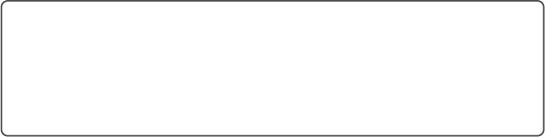

Common Network Misconfiguration
Port Group Configuration:
VLAN – 20
MTU – 9000
Team – IP hash
Port Group Configuration:
VLAN – 10
MTU – 9000
Team – Port ID
Virtual Network Configuration
_{ESXi}
_{ESXi}
vSphere Distributed Switch
Switch Port Configuration:
VLAN – 10
MTU – 1500
Team – None
Switch Port Configuration:
VLAN – 10
MTU – 9000
Team – None
Physical Network Configuration
The network health check feature sends a probe packet every 2 mins

Slide 58

Misconfiguration of Management Network
_{ESXi}
_{ESXi}
Mgmt. vmknic
Mgmt. vmknic
VMware
vCenter Server
vSphere Distributed Switch
Two different updates that triggers rollback
  Host level Rollback gets triggered when there is change in the host networking configurations such as: Physical NIC speed change, Change in MTU configuration, Change in IP settings etc..
  VDS level rollback can happen after the user updates some VDS related objects such as port group or dvports.
Notes:
The management network is configured on every host and is used to communicate with vCenter Server as well as to interact with other host during vSphere HA configuration. This is critical when it comes to centrally managing hosts through vCenter Server. If the management network on the host goes down or there is a misconfiguration, vCenter Server can’t connect to the host and thus can’t centrally manage resources.
Click1) As shown in this diagram mgmt. vmknic provide the connectivity to the vCenter server.
Click 2) If there is any issue with management network the Hosts can’t reach the vCenter server. And thus vCenter server can’t make any changes to the network and push to the hosts.
In such situation, The only way for the customer to recover is to go to individual hosts and build a standard switch with proper management network configuration. Once all the hosts have their management networks attached to a standard switch, vCenter Server can manage the hosts and re-configure the VDS.
With Rollback and recovery option customers don’t have to worry about going to standard switch route to recover from any mgmt. network failure scenario.

Slide 59
Network Best Practices
Allocate separate NICs for different traffic type
  Can be connected to same uplink/physical NIC on 10GB network
vSphere versions 5.0 and newer support multi-NIC, concurrent vMotion operations
Use NIC load-based teaming (route based on physical NIC load)
  For redundancy, load balancing, and improved vMotion speeds
Have minimum 4 NICs per host to ensure performance and redundancy of network
Recommend the use of NICs that support:
  Checksum offload , TCP segmentation offload (TSO)
  Jumbo frames (JF), Large receive offload (LRO)
  Ability to handle high-memory DMA (i.e. 64-bit DMA addresses)
  Ability to handle multiple Scatter Gather elements per Tx frame
  NICs should support offload of encapsulated packets (with VXLAN)
ALWAYS Check and Update Physical NIC Drivers
Keep VMware Tools Up-to-Date - ALWAYS

Slide 60
Network Best Practices (continued)
Use Virtual Distributed Switches for cross-ESX network convenience
Optimize IP-based storage (iSCSI and NFS)
  Enable Jumbo Frames
  Use dedicated VLAN for ESXi host's vmknic & iSCSI/NFS server to minimize network interference from other packet sources
  Exclude in-Guest iSCSI NICs from WSFC use
  Be mindful of converged networks; storage load can affect network and vice versa as they use the same physical hardware; ensure no bottlenecks in the network between the source and destination
Use VMXNET3 Para-virtualized adapter drivers to increase performance
  NEVER use any other vNIC type, unless for legacy OSes and applications
  Reduces overhead versus vlance or E1000 emulation
  Must have VMware Tools to enable VMXNET3
Tune Guest OS network buffers, maximum ports

Slide 61

Network Best Practices (continued)
  VMXNET3 can bite – but only if you let it
    ALWAYS keep VMware Tools up-to-date
    ALWAYS keep ESXi Host Firmware and Drivers up-to-date
    Choose your physical NICs wisely
    Windows Issues with VMXNET3
      Older Windows versions
      VMXNET3 template issues in Windows 2008 R2 - kb.vmware.com\kb\1020078
      Hotfix for Windows 2008 R2 VMs - http://support.microsoft.com/kb/2344941
      Hotfix for Windows 2008 R2 SP1 VMs - http://support.microsoft.com/kb/2550978
    Disable interrupt coalescing – at vNIC level
      ONLY if ALL other options fail to remedy network-related performance Issue

Slide 62



A Word on Windows RSS – Don’t Tase Me, Bro
Windows Default Behaviors
  Default RSS Behavior Result in Unbalanced CPU Usage
    Saturates CPU0, Service Network IOs
    Problem Manifested in In-Guest Packet Drops
    Problems Not Seen in vSphere Kernel, Making Problem Difficult to Detect
  Solution
    Enable RSS in 2 Places in Windows
      At the NIC Properties
        Get-NetAdapterRss |fl name, enabled
        Enable-NetAdapterRss -name <Adaptername>
      At the Windows Kernel
        Netsh int tcp show global
        Netsh int tcp set global rss=enabled
      Please See http://kb.vmware.com/kb/2008925 and http://kb.vmware.com/kb/2061598

Slide 63


Networking – The changing landscape
BCA
+

Slide 64










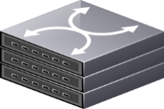
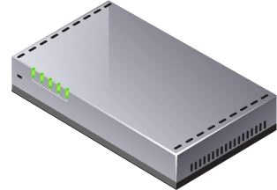
What is NSX?
VM
Network Overlay
Logical networks
Logical Routing
Logical Firewall
Logical Load Balancing
Additional Networking services (NAT, VPN, more)
Programmatically Controlled
NSX
IS Cool!!
Egress
production
src,dest,port,protocol
database tier
allow<=application tier>
customer Data
allow<appid=3456>
pci data
allow<appid=6789>
quarantine
cvss=2
L2
L3
Logical Switch (L2)
Virtual Network
In Software
L3
1.1.1.0/24
L2
Ingress
Logical Switch (L2)
Network Hypervisor
IDS
Load Balancer
General Purpose IP Hardware
Physical Network

Slide 65
What is NSX?
VM
Network Overlay
Logical networks
Logical Routing
Logical Firewall
Logical Load Balancing
Additional Networking services (NAT, VPN, more)
Programmatically Controlled
production
src,dest,port,protocol
database tier
allow<=application tier>
customer Data
allow<appid=3456>
pci data
allow<appid=6789>
quarantine
cvss=2
Egress
L2
L3
Logical Switch (L2)
Virtual Network
In Software
L3
1.1.1.0/24
L2
Ingress
Logical Switch (L2)
Network Hypervisor
IDS
Load Balancer
General Purpose IP Hardware
Physical Network

Slide 66



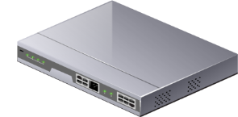
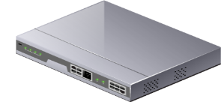
What do app owners care about?
Considerations: Consumption, Network design, Mobility
Considerations here:
Sizing, placement, config
Application
Application
Application
Workload
Workload
Workload
Software
Considerations here: BIOS: NUMA, HT, Power
Considerations here: NIC: RSS,TSO,LRO
Virtual Machine
Virtual Machine
Virtual Machine
Virtual Network
Virtual Network
Virtual Network
Server Hypervisor
Decoupled
Network Overlay
x86 Environment
Transport Layer
Requirement: x86
Hardware
General Purpose Server Hardware
General Purpose Networking Hardware

Slide 67

Performance Considerations
All you need is IP connectivity between ESXi hosts
The physical NIC and the NIC driver should support:
  TSO - TCP Segmentation Offload = NIC divides larger data chunks into TCP segments
  VXLAN offload – NIC encapsulates VXLAN instead of ESXi
  RSS – Receive side scaling, allows the NIC to distribute received traffic to multiple CPU
  LRO (Large Receive Offload) NIC reassembles incoming network packets

Slide 68











App owners say…
So if the “Network hypervisor” fail does my app fail?
What about NSX components dependencies?
Management plane:
UI, API access
Not in the data path
vCenter & NSX Manager A
Control plane:
Decouples virtual networks form physical topology
Not in Data Path
Highly Available
Controller
Cluster
Data plane: Logical switches, Distributed Routers, Distributed Firewall, Edge devices
Distributed Logical Router
Logical
Switches
DFW

Slide 69






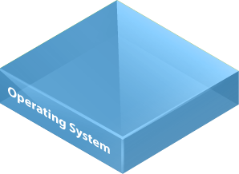

Connecting to the physical network
NSX Edge
Typical use case: 3-tier application, Web/App/DB, with non-virtualized DB tier.
Option 1 – Route using an Edge device in HA mode:
Option 2 – Route using an Edge device in ECMP mode:
Allows for stateful services such as NAT, LB, VPN.
Limited in throughput to 10Gbit (single NIC)
Failover takes a few seconds
Does NOT Allow for stateful services at the edge such as NAT, LB, VPN.
  LB can still be provided in one arm mode
  Firewall can be service by the DFW
  High throughput of upto 80Gbit
Provides highest redundancy with multipath
Physical Router
Physical Infrastructure
Routing
Adjacency
Physical Router
Routing
Adjacencies
E1
E2
E1
E2
E3
Standby
Active
…
DLR
DB
VXLAN
Web
VLAN
App
VM
VM

Slide 70
Connecting to the physical network
Typical use case: 3-tier application, Web/App/DB, with non-virtualized DB tier.
Option 3 – Bridging L2 network using software or hardware GW:
Straight from the ESXi kernel to the VLAN backed network
Lowest Latency
L2 adjacency between the tiers
Design complexity
Redundancy limitations
Physical Infrastructure
DLR
Web
App
DB
VXLAN
VM
VM
VLAN
Notes:
Instead of routing to the physical we can bridge directly from the DLR to the physical network, effectively connecting the VXLAN network directly to the VLAN backed network without going through edge devices. Though it seems appealing at first glance, and it has advantages for some use cases that require network adjacency between application components it has challenges and complexity, and most customers should not choose this option. When in doubt, route.

Slide 71
Designing for Availability

Slide 72
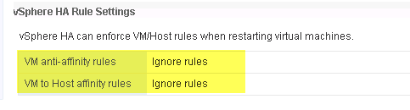

vSphere Native Availability Features
vSphere vMotion
  Can reduce virtual machine planned downtime
  Relocates VMs without end-user interruption
    Behavior COMPLETELY Configurable
  Enables Admin to perform on-demand host maintenance without service interruption
vSphere DRS
  Monitors state of virtual machine resource usage
  Can automatically and intelligently locate virtual machine
  Can create a dynamically balanced Exchange Server deployment
  Uses vMotion. Behavior COMPLETELY Configurable
vSphere High Availability (HA)
  HA Evaluates DRS Rules BEFORE Recovery – Just a checkbox operation
    * Now DEFAULT BEHAVIOR is vSphere 6.5
  Does not require Vendor-specific clustering solutions
  NOT a replacement for app-specific native HA features
  COMPLEMENTS and ENHANCES app-specific HA features
  Automatically restarts failed virtual machine in minutes

Slide 73
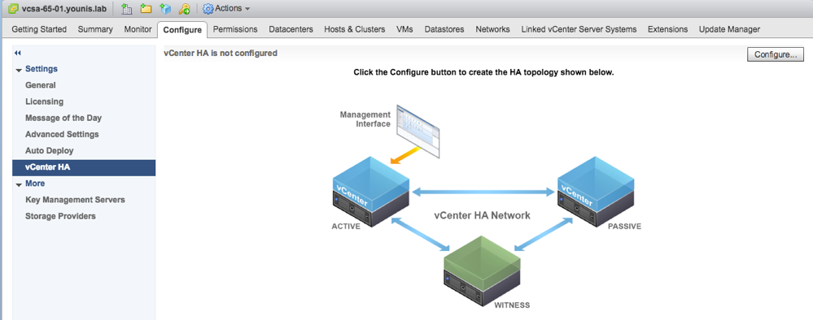
vSphere Native Availability Feature Enhancements – vSphere 6.5
vCenter High Availability
  vCenter Server Appliance ONLY
  Active, Passive, and Witness nodes – Exact Clones of existing vCenter Server.
  Protects vCenter against Host, Appliance or Component Failures
  5-minute RTO at release

Slide 74
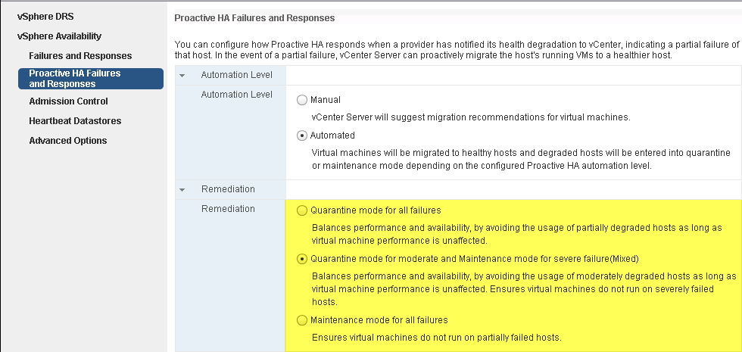
vSphere Native Availability Feature Enhancements – vSphere 6.5
Proactive High Availability
  Detects ESXi Host hardware failure or degradation
  Leverage Hardware Vendor-provided plugin for monitoring Host
  Reports Hardware state to vCenter
  Unhealthy or failed hardware component is categorized based on SEVERITY
  Puts impacted Hosts one of 2 states:
    Quarantine Mode:
      Existing VMs on Host not IMMEDIATELY evacuated.
      Now new VM placed on Host
      DRS attempts to remove Host if no performance impact to workloads in Cluster
    Maintenance Mode:
      Existing VMs on Host Evacuated
      Host no longer participates in Cluster

Slide 75
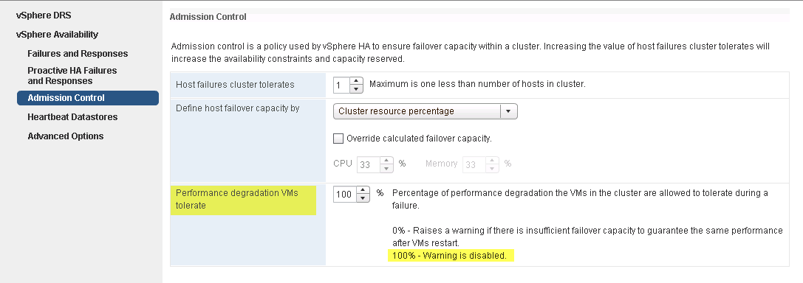
vSphere Native Availability Feature Enhancements – vSphere 6.5
Continuous VM Availability
  For when VMs MUST be up, even at the expense of PERFORMANCE

Slide 76
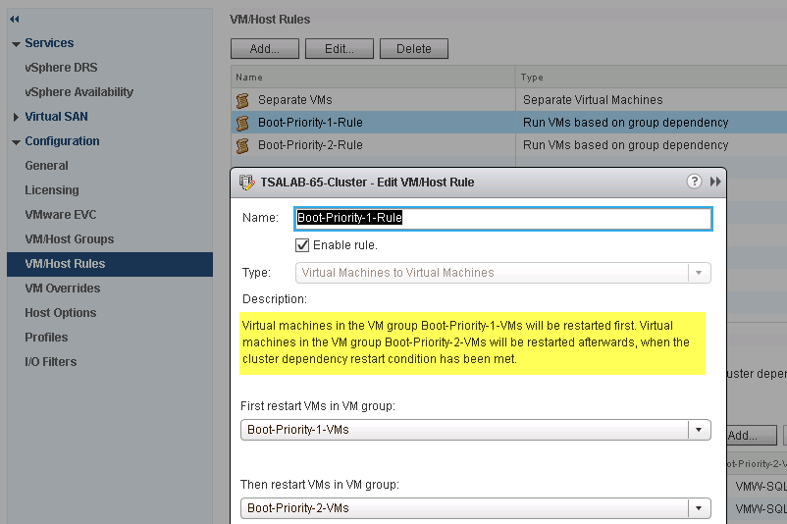
vSphere Native Availability Feature Enhancements – vSphere 6.5
vSphere DRS Rules
  Rules now includes “VM Dependencies”
  Allows VMs to be recovered in order of PRIORITIES

Slide 77
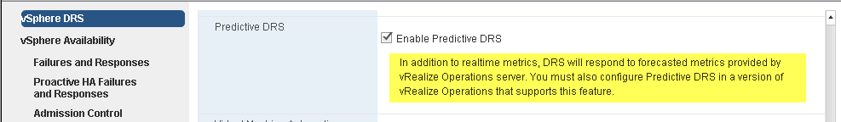
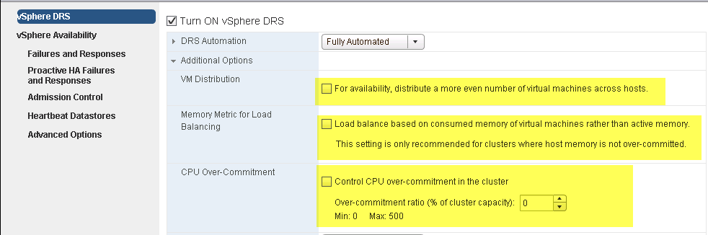
vSphere Native Availability Feature Enhancements – vSphere 6.5
Predictive DRS
    Integrated with VMware’s vRealize Operations Monitoring Capabilities
Network-Aware DRS
  Considers Host’s Network Bandwith Utilization for VM Placement
  Does NOT Evacuate VMs Based on Utilization
Simplified Advanced DRS Configuration Tasks
  Now just Checkbox options

Slide 78
Combining Windows Applications HA with vSphere HA Features
– The Caveats

Slide 79

Are You Going to Cluster THAT?
Do you NEED App-level Clustering?
  Purely business and administrative decision
  Virtualization does not preclude you from doing so
Share-nothing Application Clustering?
  No “Special” requirements on vSphere
Shared-Disk Application Clustering (e.g. FCI / MSCS)
  You MUST use Raw Device Mapping (RDM) Disks Type for Shared Disks
  MUST be connected to vSCSI controllers in PHYSICAL Mode Bus Sharing
  Wonder why it’s called “Physical Mode RDM”, eh?
  In Pre-vSphere 6.0, FCI/MSCS nodes CANNOT be vMotioned. Period
  In vSphere 6.0 and above, you have vMotions capabilities under following conditions
    Clustered VMs are at Hardware Version > 10
    vMotion VMKernel Portgroup Connected to 10GB Network

Slide 80
vMotioning Clustered Windows Nodes – Avoid the Pitfall
Clustered Windows Applications Use Windows Server Failover Clustering (WSFC)
  WSFC has a Default 5 Seconds Heartbeat Timeout Threshold
  vMotion Operations MAY Exceed 5 Seconds (During VM Quiescing)
    Leading to Unintended and Disruptive Clustered Resource Failover Events
SOLUTION
  Use MULTIPLE vMotion Portgroups, where possible
  Enable jumbo frames on all vmkernel ports, IF PHYSICAL Network Supports it
  If jumbo frames is not supported, consider modifying default WSFC behaviors:
    (get-cluster).SameSubnetThreshold = 10
    (get-cluster).CrossSubnetThreshold = 20
    (get-cluster).RouteHistoryLength = 40
    NOTES:
      You may need to “Import-Module FailoverClusters” first
Behavior NOT Unique to VMware or Virtualization
  If Your Backup Software Quiesces Exchange, You Experience Symptom
  See Microsoft’s “Tuning Failover Cluster Network Thresholds” – http://bit.ly/1nJRPs3

Slide 81
Monitoring and Identifying Performance Bottlenecks

Slide 82





Performance Needs Monitoring at Every Level
Application
Guest OS
Application Level
App Specific Perf tools/stats
Guest OS
CPU Utilization, Memory Utilization, I/O Latency
Virtualization Level
vCenter Performance Metrics /Charts
Limits, Shares, Virtualization Contention
Physical Server Level
CPU and Memory Saturation, Power Saving
Connectivity Level
Network/FC Switches and data paths
Packet loss, Bandwidth Utilization
Peripherals Level
SAN or NAS Devices
Utilization, Latency, Throughput
ESXi Stack
START
HERE
Physical Server
Connectivity
Peripherals

Slide 83
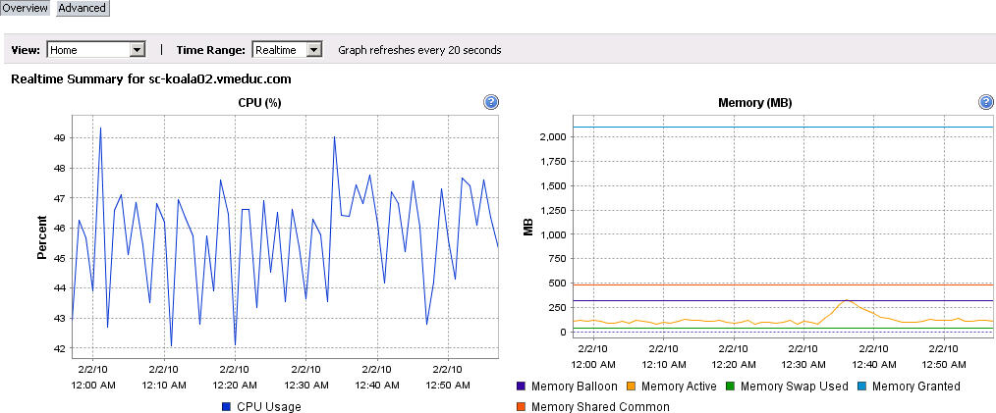
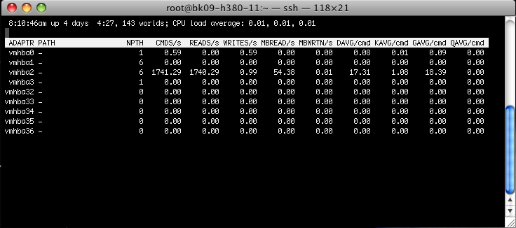
Host Level Monitoring
VMware vSphere Client™
  GUI interface, primary tool for observing performance and configuration data for one or more vSphere hosts
  Does not require high levels of privilege to access the data
Resxtop/ESXTop
  Gives access to detailed performance data of a single vSphere host
  Provides fast access to a large number of performance metrics
  Runs in interactive, batch, or replay mode
  ESXTop Cheat Sheet - http://www.running-system.com/vsphere-6-esxtop-quick-overview-for-troubleshooting/

Slide 84
Key Metrics to Monitor for vSphere
Resource | Metric | Host / VM | Description
CPU | %USED | Both | CPU used over the collection interval (%)
 | %RDY | VM | CPU time spent in ready state
 | %SYS | Both | Percentage of time spent in the ESX Server VMKernel
Memory | Swapin, Swapout | Both | Memory ESX host swaps in/out from/to disk (per VM, or cumulative over host)
 | MCTLSZ (MB) | Both | Amount of memory reclaimed from resource pool by way of ballooning
Disk | READs/s, WRITEs/s | Both | Reads and Writes issued in the collection interval
 | DAVG/cmd | Both | Average latency (ms) of the device (LUN)
 | KAVG/cmd | Both | Average latency (ms) in the VMkernel, also known as “queuing time”
 | GAVG/cmd | Both | Average latency (ms) in the guest. GAVG = DAVG + KAVG
Network | MbRX/s, MbTX/s | Both | Amount of data transmitted per second
 | PKTRX/s, PKTTX/s | Both | Packets transmitted per second
 | %DRPRX, %DRPTX | Both | Drop packets per second
Notes:
84

Slide 85
Key Indicators
CPU
Ready (%RDY)
  % time a vCPU was ready to be scheduled on a physical processor but couldn't’t due to processor contention
  Investigation Threshold: 10% per vCPU
Co-Stop (%CSTP)
  % time a vCPU in an SMP virtual machine is “stopped” from executing, so that another vCPU in the same virtual machine could be run to “catch-up” and make sure the skew between the two virtual processors doesn't grow too large
  Investigation Threshold: 3%
Max Limited (%MLMTD)
  % time VM was ready to run but wasn’t scheduled because it violated the CPU Limit set ; added to %RDY time
  Virtual machine level – processor queue length

Slide 86
Key Performance Indicators
Memory
Balloon driver size (MCTLSZ)
  the total amount of guest physical memory reclaimed by the balloon driver
  Investigation Threshold: 1
Swapping (SWCUR)
  the current amount of guest physical memory that is swapped out to the ESX kernel VM swap file.
  Investigation Threshold: 1
Swap Reads/sec (SWR/s)
  the rate at which machine memory is swapped in from disk.
  Investigation Threshold: 1
Swap Writes/sec (SWW/s)
  The rate at which machine memory is swapped out to disk.
  Investigation Threshold: 1
  Network
  Transmit Dropped Packets (%DRPTX)
    The percentage of transmit packets dropped.
    Investigation Threshold: 1
  Receive Dropped Packets (%DRPRX)
    The percentage of receive packets dropped.
    Investigation Threshold: 1

Slide 87



Logical Storage Layers: from Physical Disks to vmdks
GAVG
Tracks latency of I/O in the guest VM
Investigation Threshold: 15-20ms
Guest OS disk
Virtual
Machine
.vmdk file
VMware
Data store
(VMFS
Volume)
KAVG
Tracks latency of I/O passing thru the Kernel
Investigation Threshold: 1ms
DAVG
Tracks latency at the device driver; includes round-trip time between HBA and storage
Investigation Threshold: 15 - 20ms, lower is better, some spikes okay
Aborts (ABRT/s)
# commands aborted / sec
Investigation Threshold: 1
Storage LUN
Physical
Disks
Storage Array

Slide 88
Key Indicators
Storage
Kernel Latency Average (KAVG)
  This counter tracks the latencies of IO passing thru the Kernel
  Investigation Threshold: 1ms
Device Latency Average (DAVG)
  This is the latency seen at the device driver level. It includes the roundtrip time between the HBA and the storage.
  Investigation Threshold: 15-20ms, lower is better, some spikes okay
Aborts (ABRT/s)
  The number of commands aborted per second.
  Investigation Threshold: 1
Size Storage Arrays appropriately for Total VM usage
  > 15-20ms Disk Latency could be a performance problem
  > 1ms Kernel Latency could be a performance problem or a undersized ESX device queue

Slide 89
Storage Performance
Troubleshooting Tools

Slide 90

Storage Profiling Tips and Tricks
Common IO Profiles (database, web, etc): http://blogs.msdn.com/b/tvoellm/archive/2009/05/07/useful-io-profiles-for-simulating-various-workloads.aspx
Make Sure to Check / Try:
  Load balancing / multi-pathing
  Queue depth & outstanding I/Os
  pvSCSI Device Driver
Look out for:
  I/O contention
  Disk Shares
  SIOC & SDRS
  IOP Limits

Slide 91
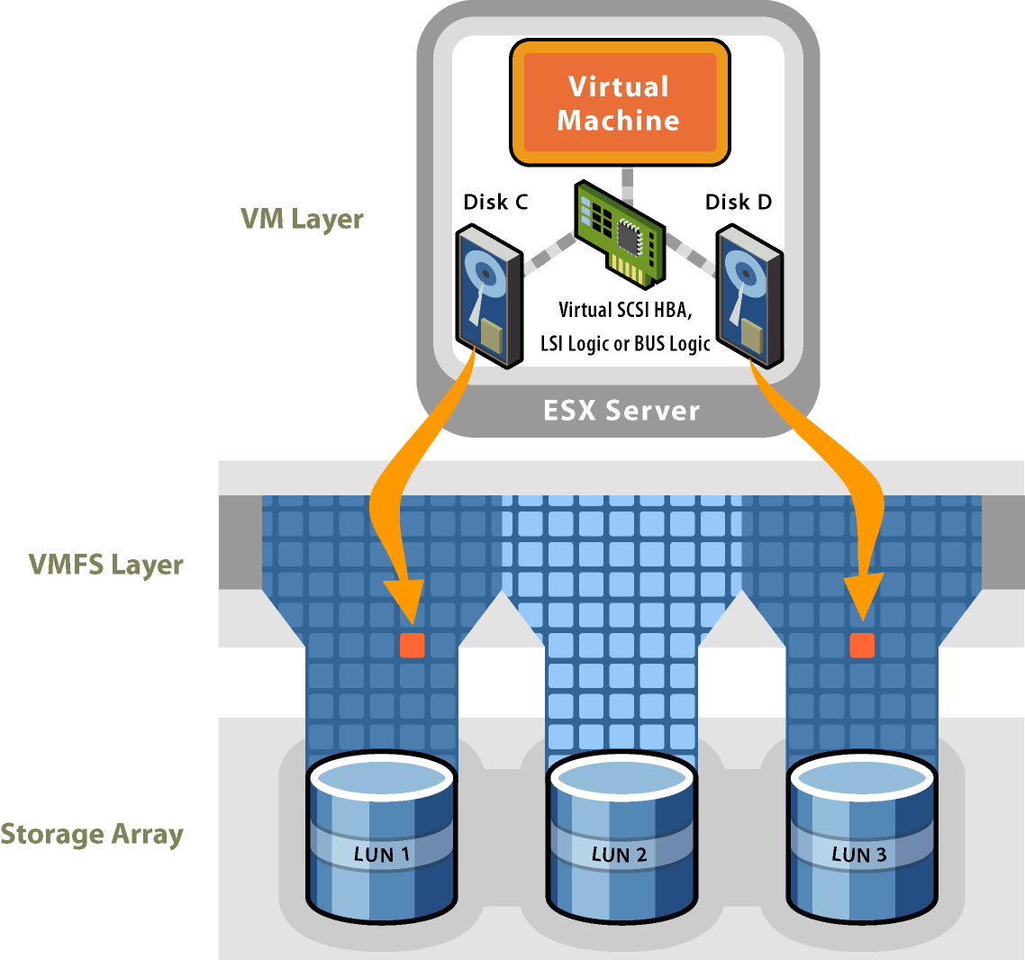
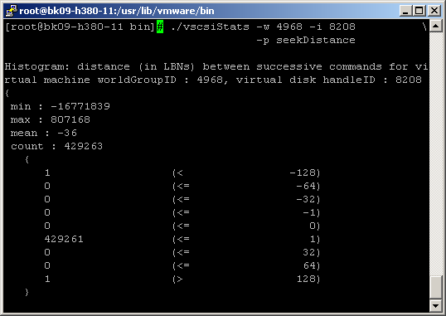
vscsiStats – DEEP Storage Diagnostics
vscsiStats characterizes IO for each virtual disk
  Allows us to separate out each different type of workload into its own container and observe trends
Histograms only collected if enabled; no overhead otherwise
Metrics
  I/O Size
  Seek Distance
  Outstanding I/Os
  I/O Interarrival Times
  Latency

Slide 92
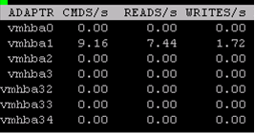
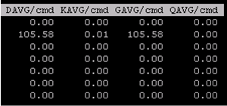
Monitoring Disk Performance with esxtop
…
very large values
for DAVG/cmd and GAVG/cmd
Rule of thumb
  GAVG/cmd > 20ms = high latency!
What does this mean?
  When command reaches device, latency is high
  Latency as seen by the guest is high
  Low KAVG/cmd means command is not queuing in VMkernel

Slide 93
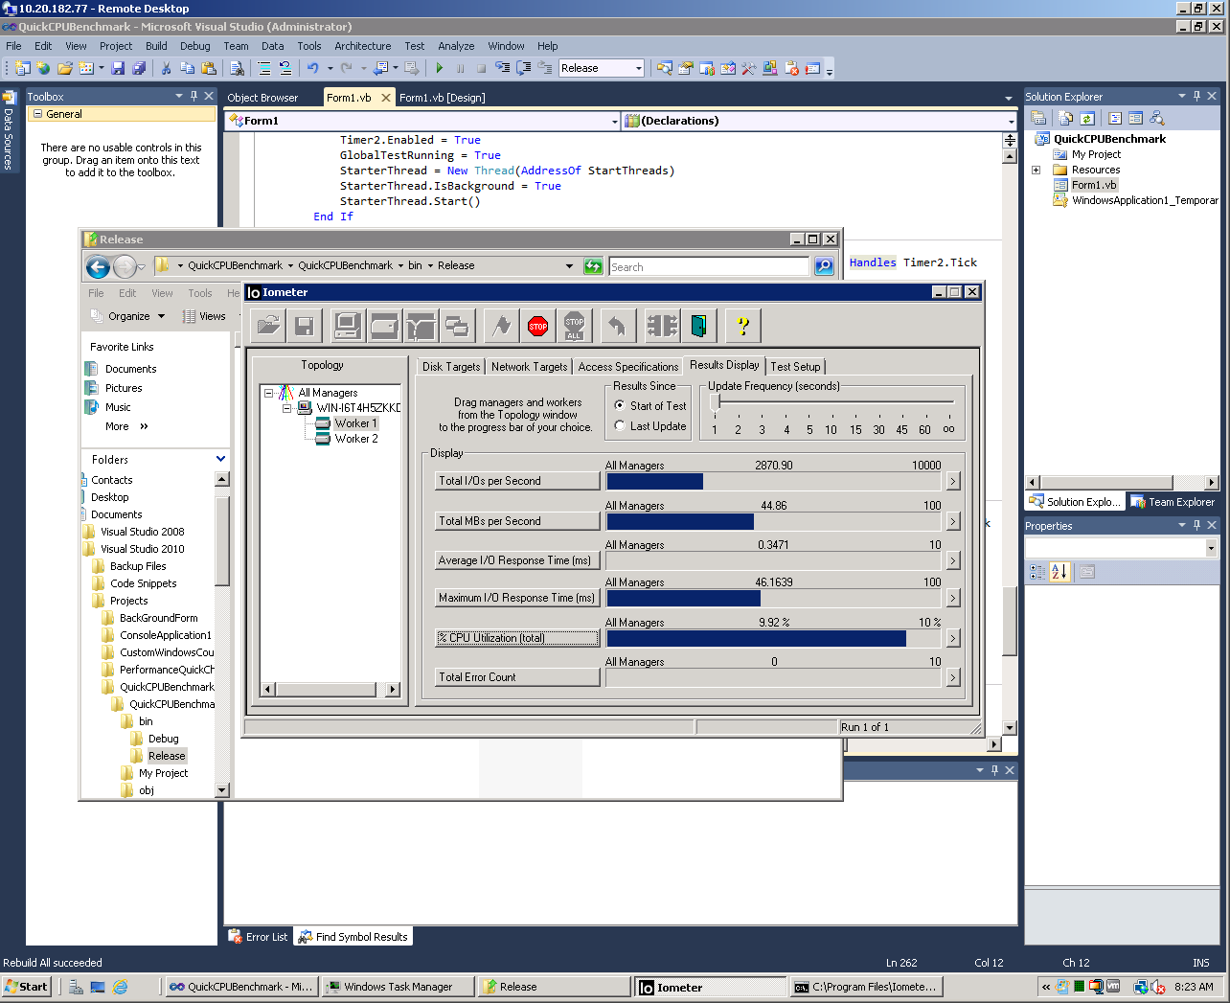
Iometer
An I/O subsystem measurement and characterization tool for single and clustered systems.
Supports Windows and Linux
Windows and Linux
Free (Open Source)
Single or Multi-server capable
Multi-threaded
Metrics Collected
  Total I/Os per Sec.
  Throughput (MB)
  CPU Utilization
  Latency (avg. & max)

Slide 94
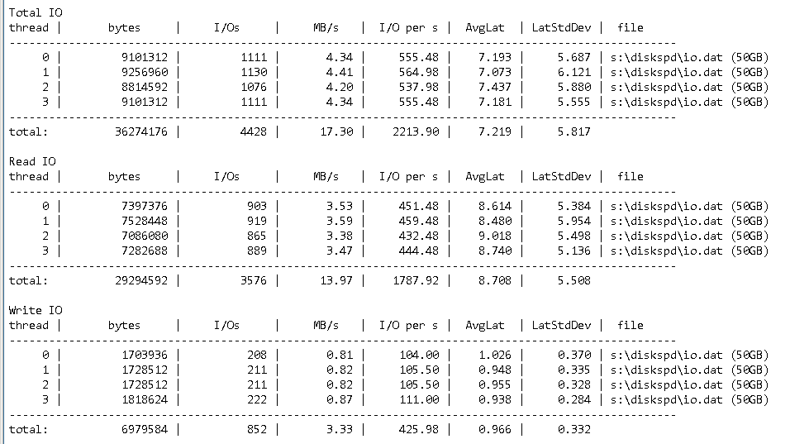
DiskSpd Utility: A Robust Storage Testing Tool (SQLIO)
https://gallery.technet.microsoft.com/DiskSpd-a-robust-storage-6cd2f223
http://hfxte.ch/diskspd
Windows-based feature-rich synthetic storage testing and validation tool
Replaces SQLIO and effective for baselining storage for MS SQL Server workloads
Fine-grained IO workload characteristics definition
Configurable runtime and output options
Intelligent and easy-to-understand tabular summary in text-based output

Slide 95
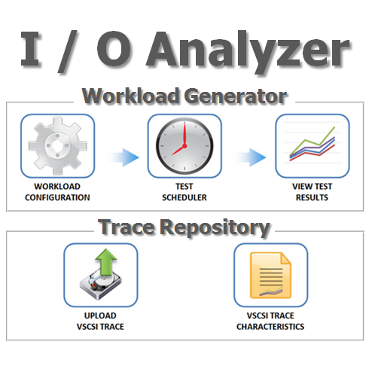
I/O Analyzer
A virtual appliance solution
Provides a simple and standardized way of measuring storage performance.
http://labs.vmware.com/flings/io-analyzer
Readily deployable virtual appliance
Easy configuration and launch of I/O tests on one or more hosts
I/O trace replay as an additional workload generator
Ability to upload I/O traces for automatic extraction of vital metrics
Graphical visualization

Slide 96
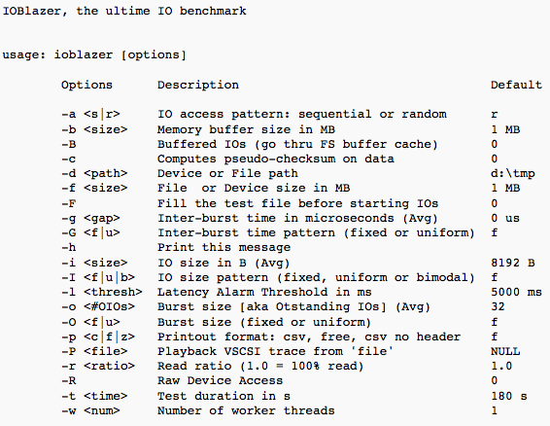
IO Blazer
Multi-platform storage stack micro-benchmark.
Supports Linux, Windows and OSX.
http://labs.vmware.com/flings/ioblazer
Capable of generating a highly customizable workloads
Parameters like: IO size, number of outstanding Ios, interarrival time, read vs. write mix, buffered vs. direct IO
IOBlazer is also capable of playing back VSCSI traces captured using vscsiStats.
Metrics reported are throughput and IO latency.

Slide 97
Disaster Recovery with
VMware Site Recovery Manager (SRM)

Slide 98



Architectural model #1 – Dedicated 1 to 1 Architecture
Customer A
Customer B
VC
VC
SRM-A
SRM-B
VRMS
VRMS
Provider
Cluster A
VRS
Provider
Cluster B
VRS
VC
VC
SRM-A
SRM-B
VRMS
VRMS

Slide 99
Pros and Cons of 1 to 1 paired architecture
Pros | Cons
Ensures customer isolation | Highest cost model
Dedicated resources per consumer | High level of ongoing management
Can provide full admin rights to consumers | Wasted resources during non-failover times
Easy self-service for consumers
Well known and traditional model for configuration
Easy upgrades
Custom options allowable per consumer

Slide 100
Use Case – Shared N to 1 Architecture
Customer A
Customer B
VC
VC
SRM-A
SRM-B
VRMS
VRMS
Provider
Cluster
VRS
VRS
VRS
VRS
VRS
VRS
VRS
VC
SRM-A
SRM-B
VRMS

Slide 101
Use Case - DR as a Service (DRaaS) N:1 provider model layout
VC
VRMS
Cust 1
DRaaS Provider
SRM-Cust1
VC
VRMS
VC
VRMS
VR Server
VR Server
Cust 2
VR Server
SRM-Cust2
SRM-Cust1
SRM-Cust2
VC
VRMS
SRM-Cust3
Cust 3
SRM-Cust3

Slide 102
Use Case – DR as a Service (DRaaS) provider model
Minimum Component Requirements
    Same as site-to-site requirements
    Remote customer site SRM “pairs” installed using SRM shared site option
    Remote customer site VRMS connection paired to recovery site VRMS as per default VRMS setup
    Typically provider runs whole solution as a managed service
    Provider usually own / administer all component VM’s (SRM servers etc.) to reduce security complexities (i.e. user accounts / credentials)
    Current targeted N:1 limit is 10:1 meaning for each vCenter at the provider site there can be up to 10 inbound customers. To go beyond this scale out by adding additional clusters with own dedicated vCenter/VRMS/VR components
    Up to 500 VMs can be protected by VR under a single framework
Host Requirements
    Remote site VMs protected with vSphere Replication
      You WILL need ESXi hosts to run those VMs on
      Typically, provider will configure VR at customer site

Slide 103
Pros and Cons of Shared N to 1 architecture
Pros | Cons
Lower cost of infrastructure | Difficult coordinated upgrades
Ease of management | Difficult to isolate customer environments
Ease of scaling | Cluster-wide events affect every customer
Central management of customer environments | More difficult to provide self-service
 | Requires extensive role and permission management
 | Scalability limits of 10:1

Slide 104
Resources

Slide 105
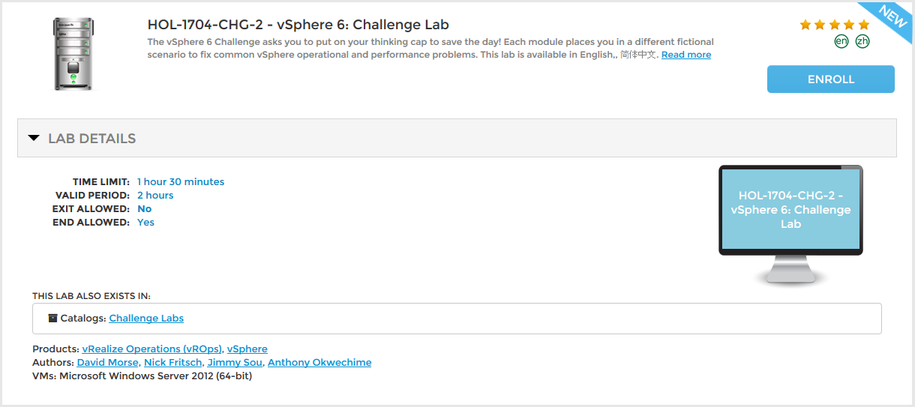
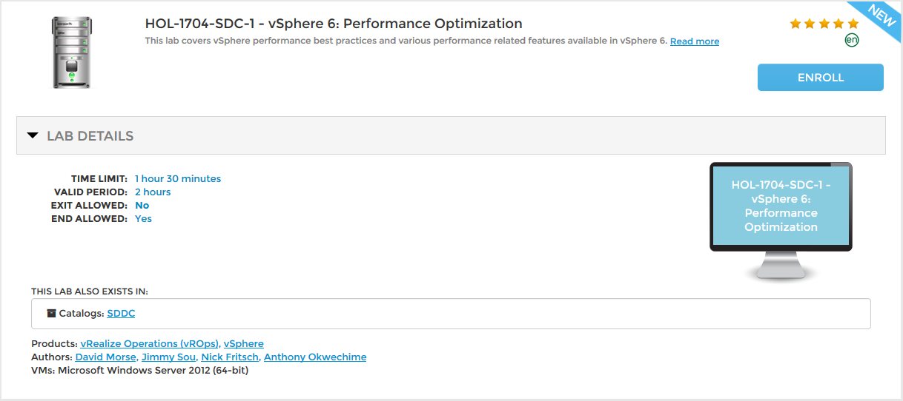

VMware Hands-on Labs
http://labs.hol.vmware.com/HOL/catalogs/catalog/131

Slide 106
The Links are Free. Really
Virtualizing Business Critical Applications
  http://www.vmware.com/solutions/business-critical-apps/
  http://blogs.vmware.com/apps
VMware vSphere 6.5 Document
  https://www.vmware.com/support/pubs/vsphere-esxi-vcenter-server-6-pubs.html
  https://pubs.vmware.com/vsphere-65/index.jsp
  http://pubs.vmware.com/vsphere-65/topic/com.vmware.ICbase/PDF/vsphere-esxi-vcenter-server-65-setup-mscs.pdf
VMware’s Performance – Technical Papers
  https://www.vmware.com/pdf/vsphere6/r65/vsphere-65-configuration-maximums.pdf
  http://www.vmware.com/files/pdf/techpaper/VMW-Tuning-Latency-Sensitive-Workloads.pdf
  http://pubs.vmware.com/vsphere-65/topic/com.vmware.ICbase/PDF/vsphere-esxi-vcenter-server-65-monitoring-performance-guide.pdf
  http://www.vmware.com/files/pdf/techpaper/VMware-PerfBest-Practices-vSphere6-0.pdf
  http://www.vmware.com/pdf/Perf_Best_Practices_vSphere5.5.pdf
  http://www.running-system.com/vsphere-6-esxtop-quick-overview-for-troubleshooting/ - ESXTop Cheat Sheet
  VMware vSphere Data Protection Documentation page

Slide 107
Questions? #rtfm

Slide 108
Thanks for attending

